Slide 1

Waltham Forest :
The first London Borough of Culture

Slide 2






Ready to deliver:
London Borough of Culture 2019

Slide 3
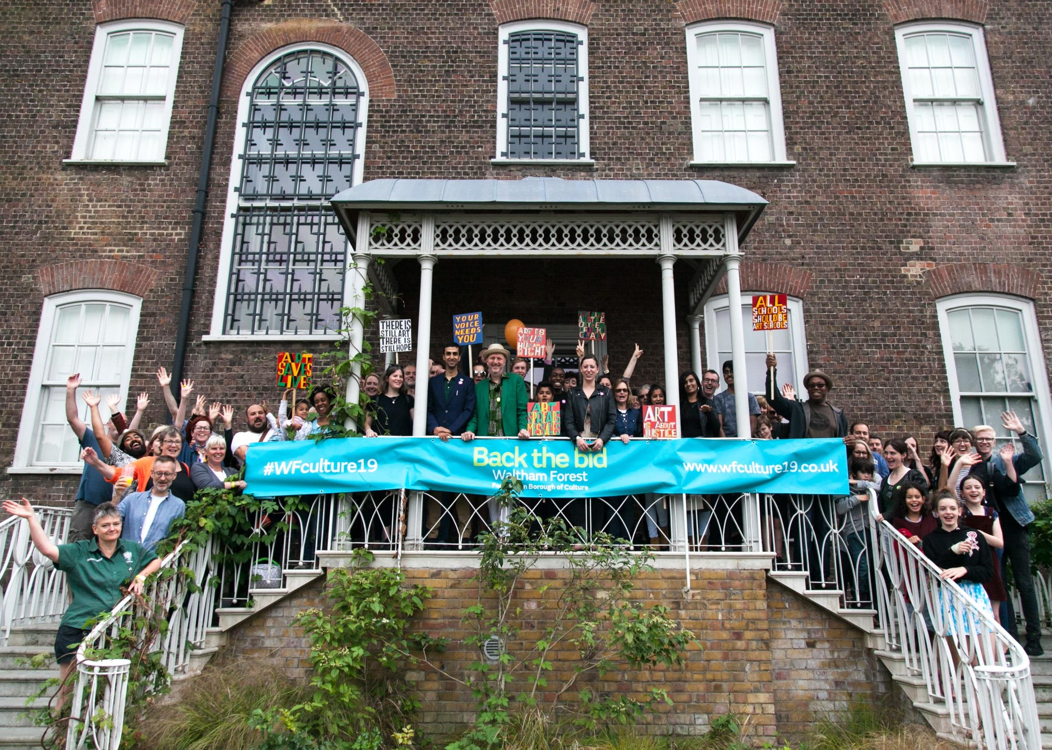
COMMUNITY AT ITS HEART

Slide 4
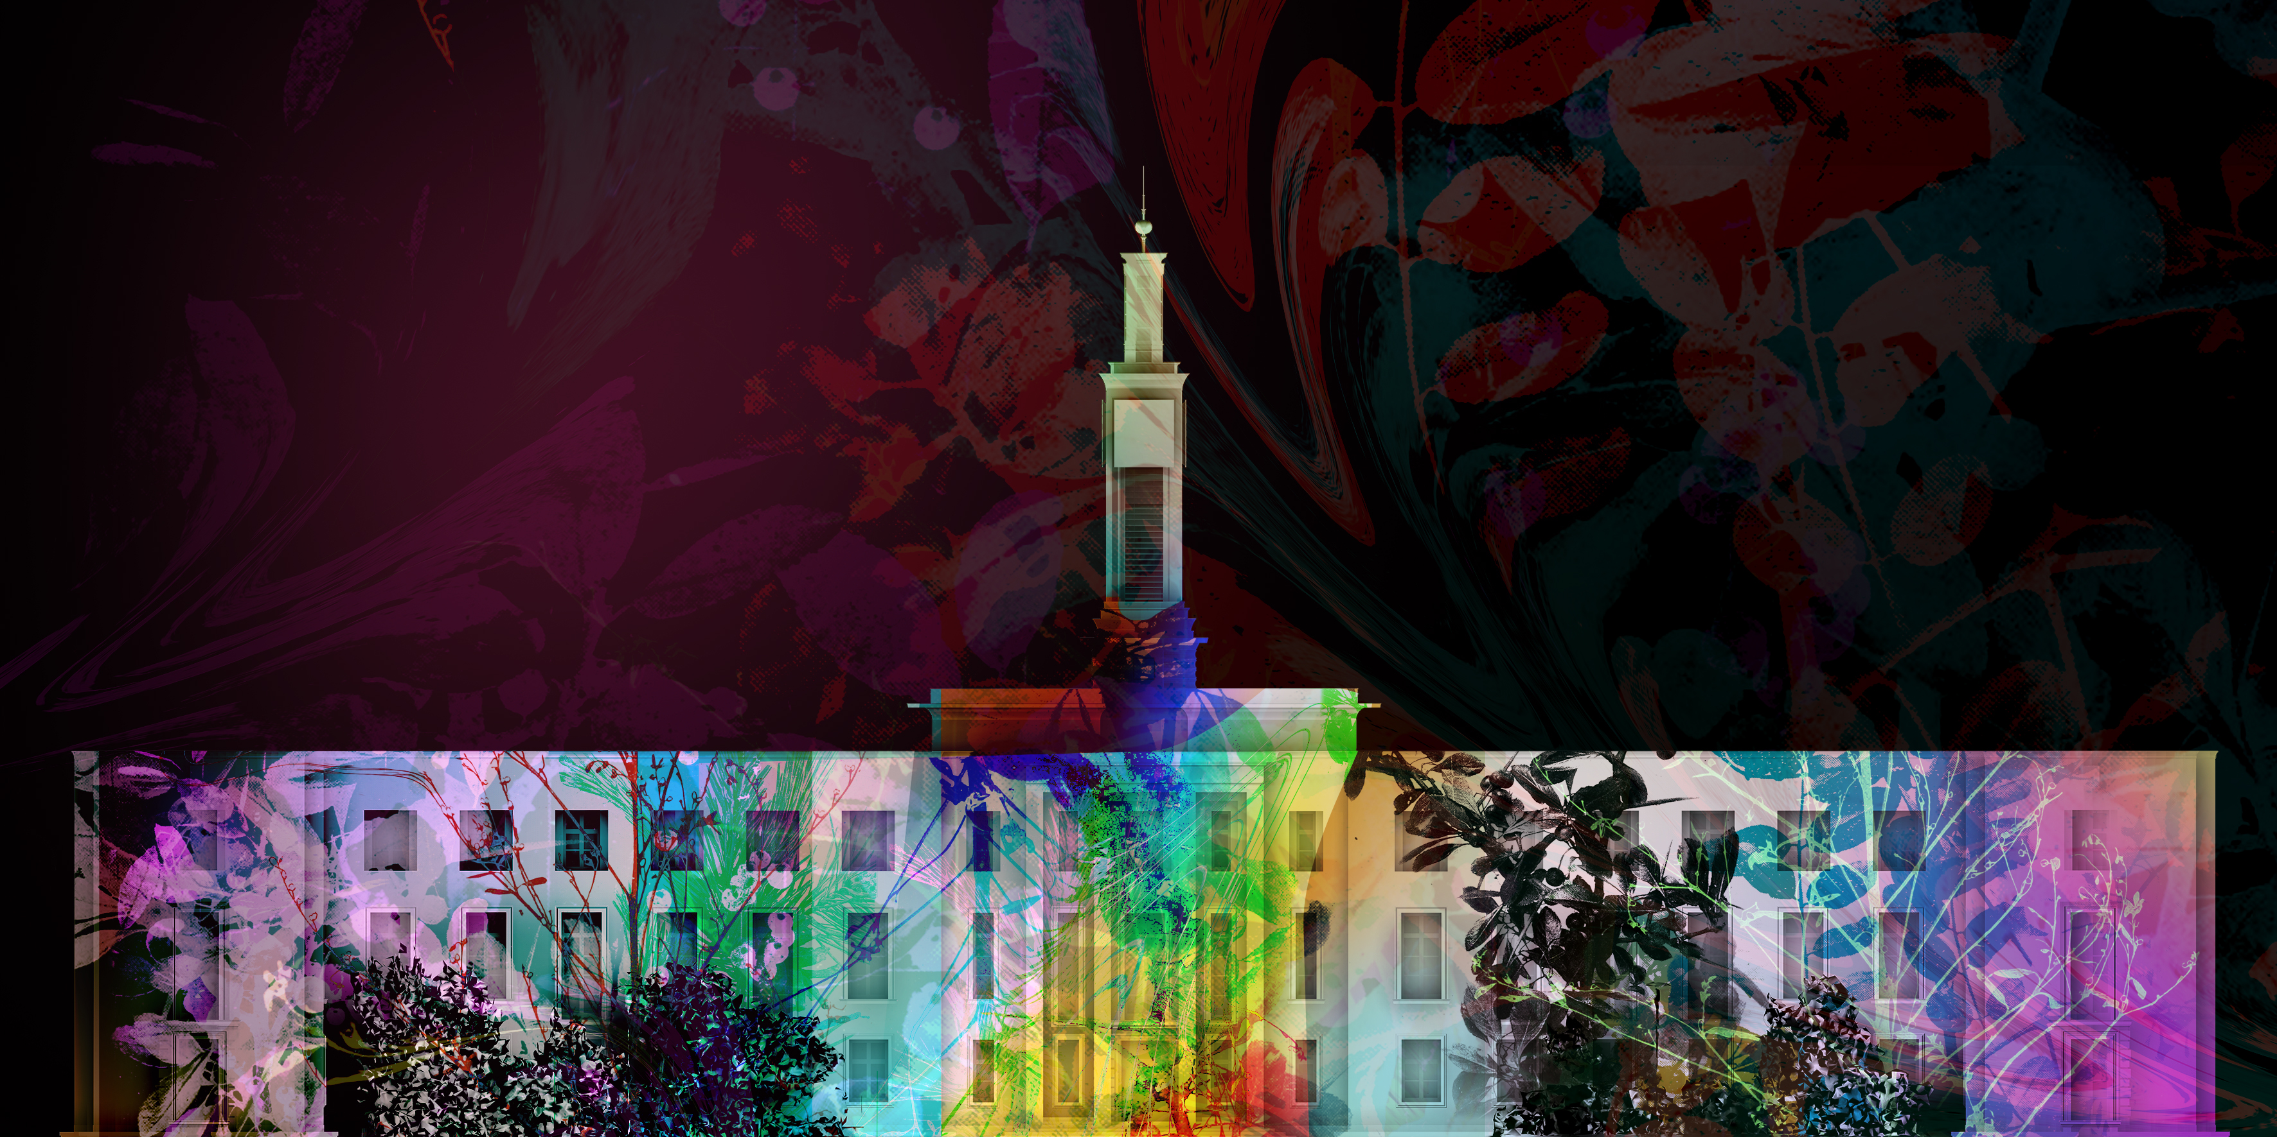
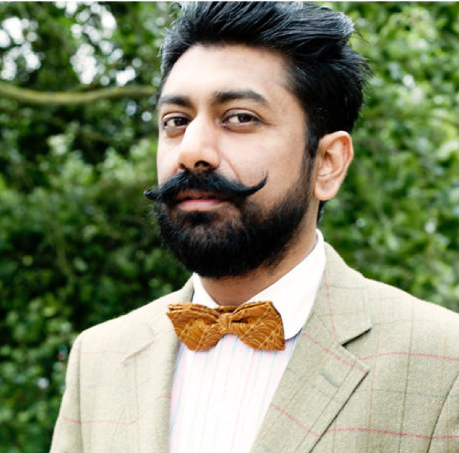
Part One, Waltham Forest Town Hall
A collaboration between Mercury
award-winning Talvin Singh, digital
artists Greenaway & Greenaway
and electronic music’s Addictive TV
Welcome to the Forest, Opening Event
WHEN: 11-13 January WHERE: Walthamstow
Notes:
TWO PROJECTIONS ONTO WG TOWN HALL

Slide 5
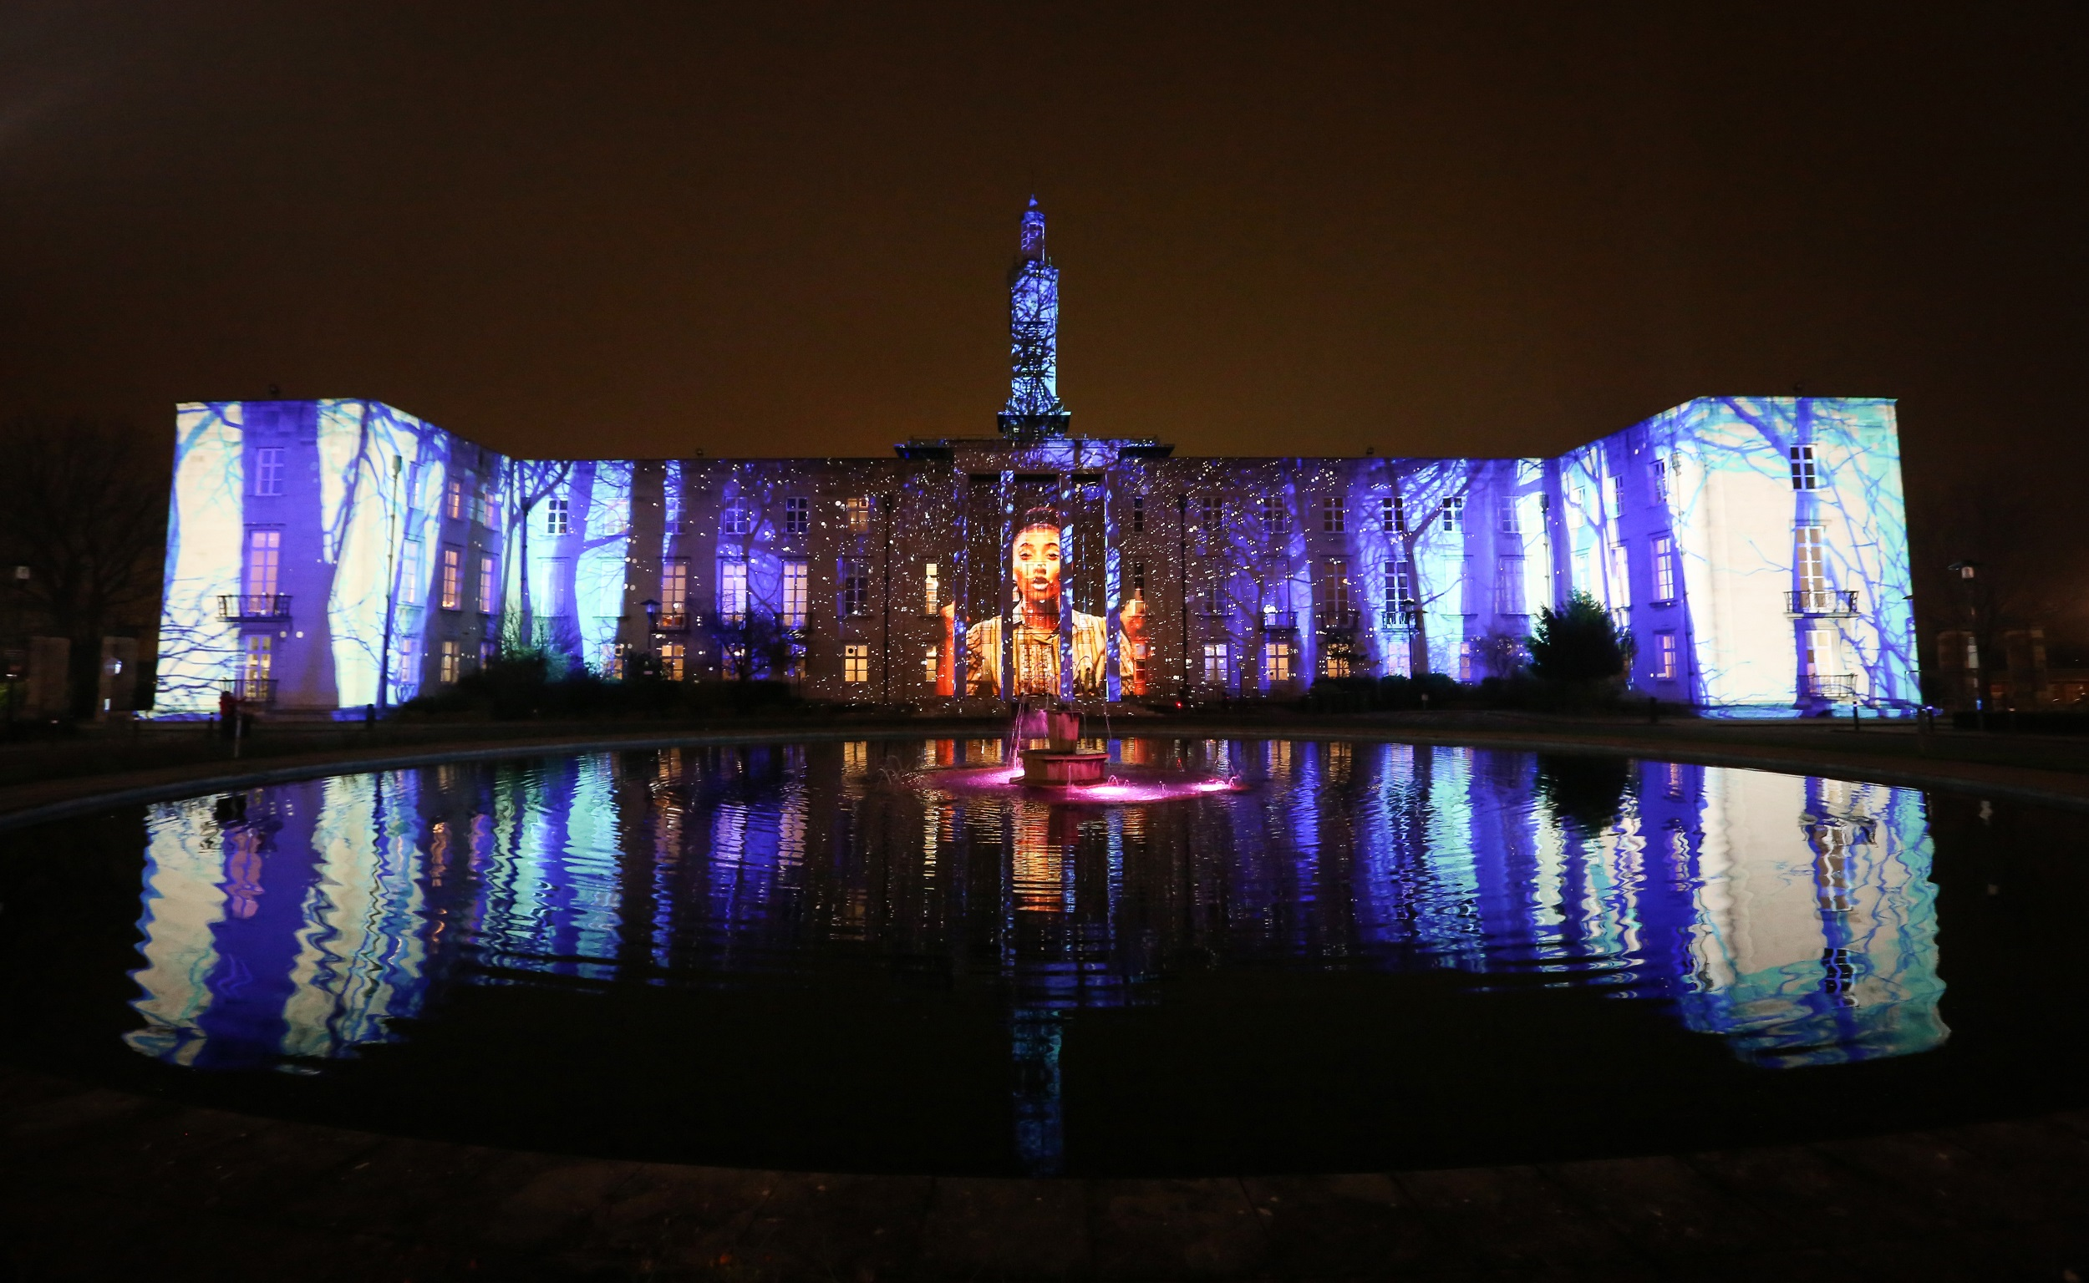

Slide 6
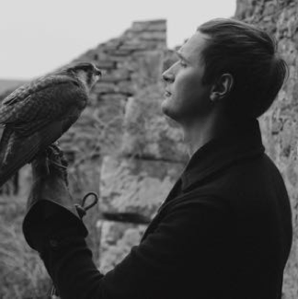
Part Two, Lloyd Park
Internationally renowned Marshmallow Laser Feast will create the kinetic light sculpture Nest set to a soundscape by Erland Cooper.
Welcome to the Forest, Opening Event
WHEN: 11-13 January WHERE: Walthamstow

Slide 7
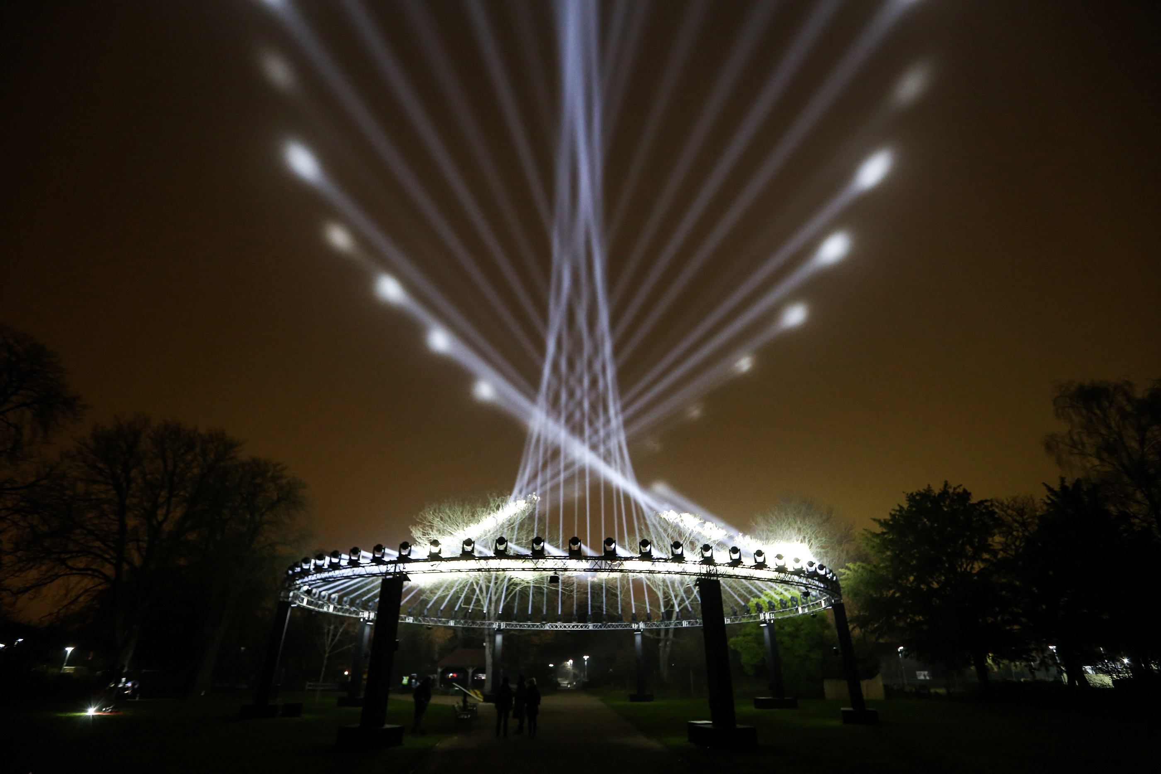
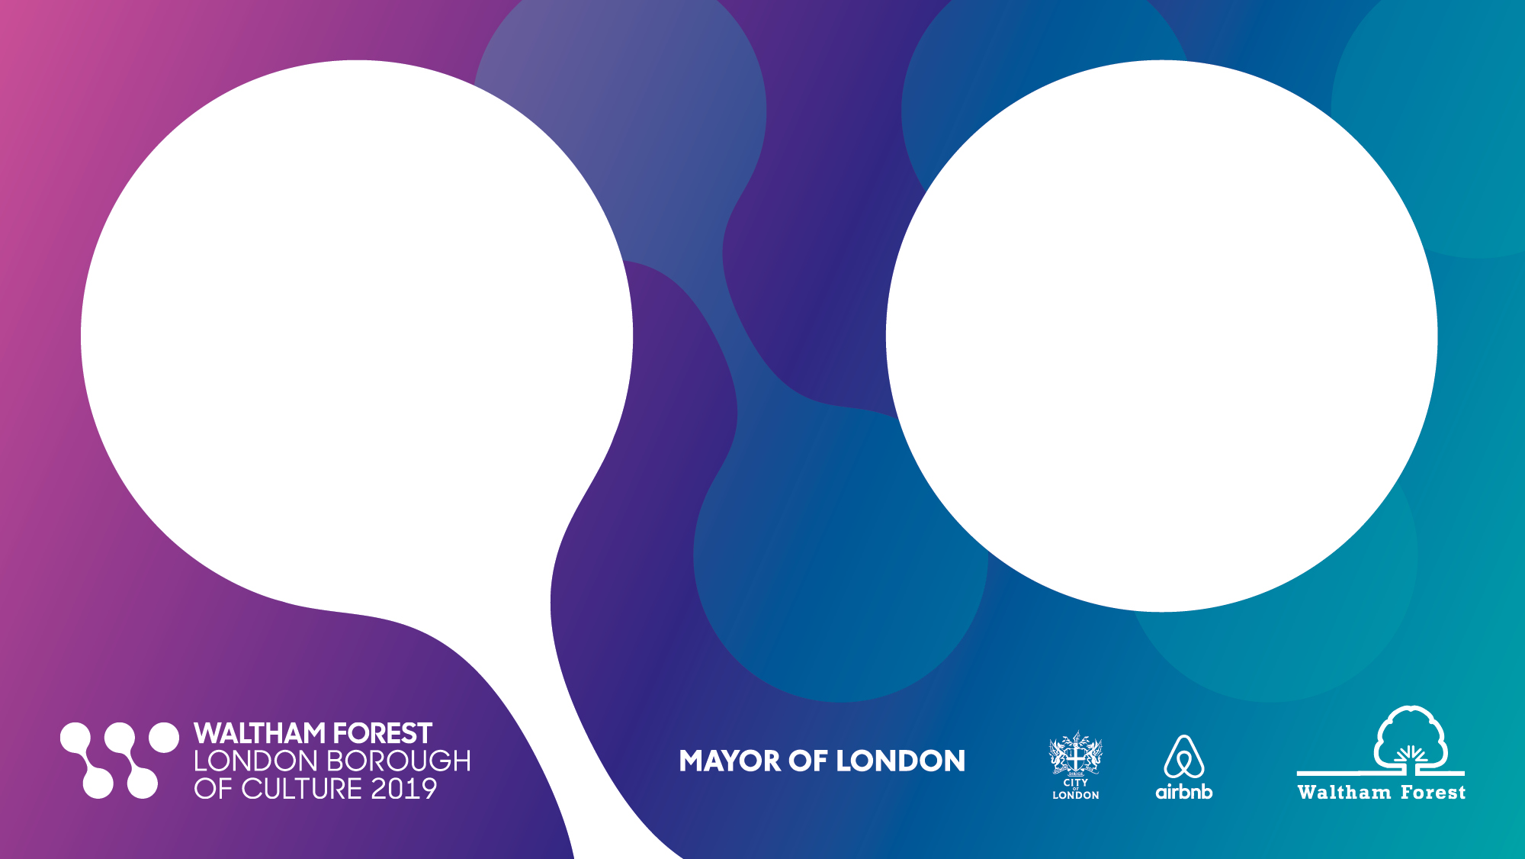
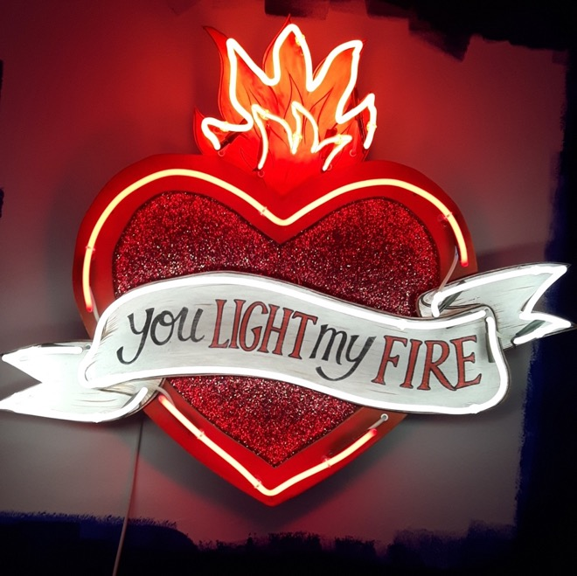
Everyone is invited to be part of the year

Slide 8


Atomic 50, immersive journey of making and metalwork
WHEN: March – May WHERE: Leyton

Slide 9
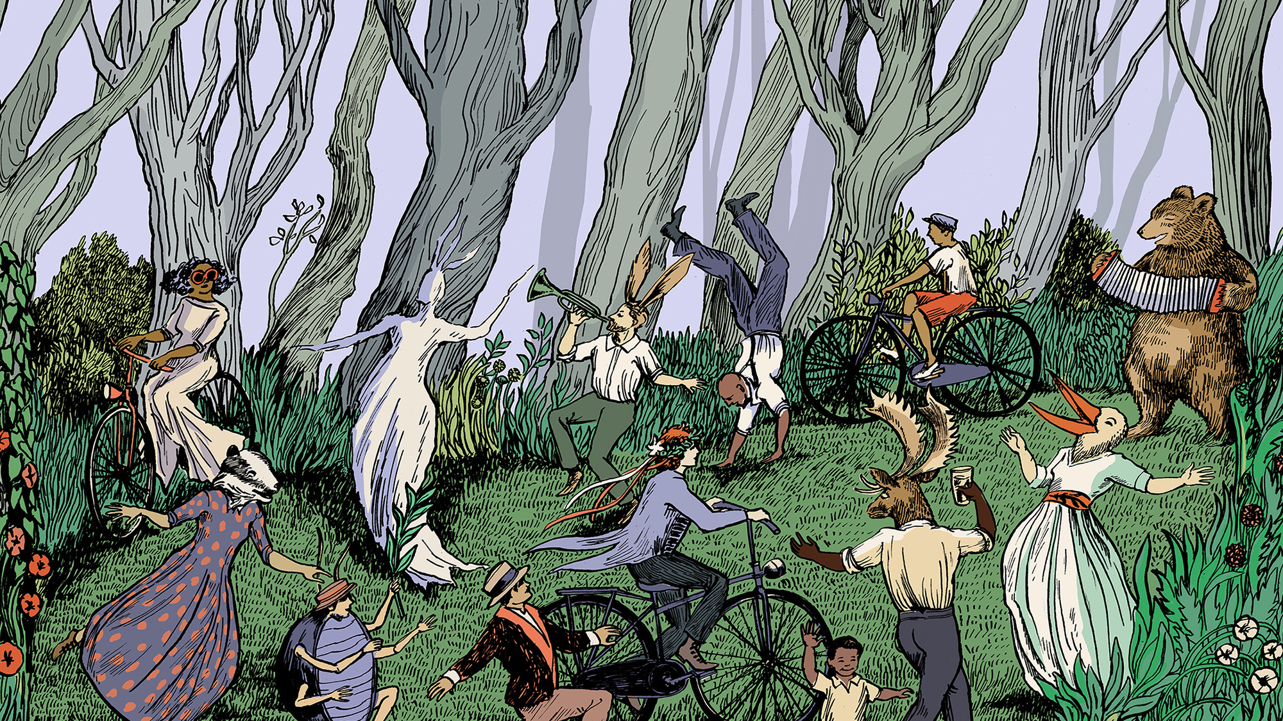
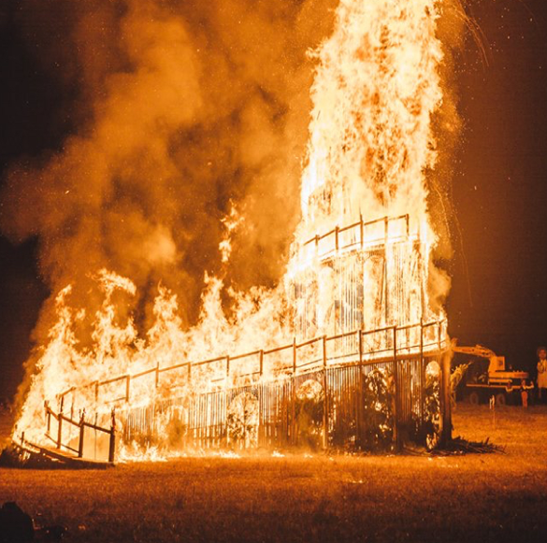
Chingford May Day Fayre, part of The People’s Forest
WHERE: Chingford Plains

Slide 10
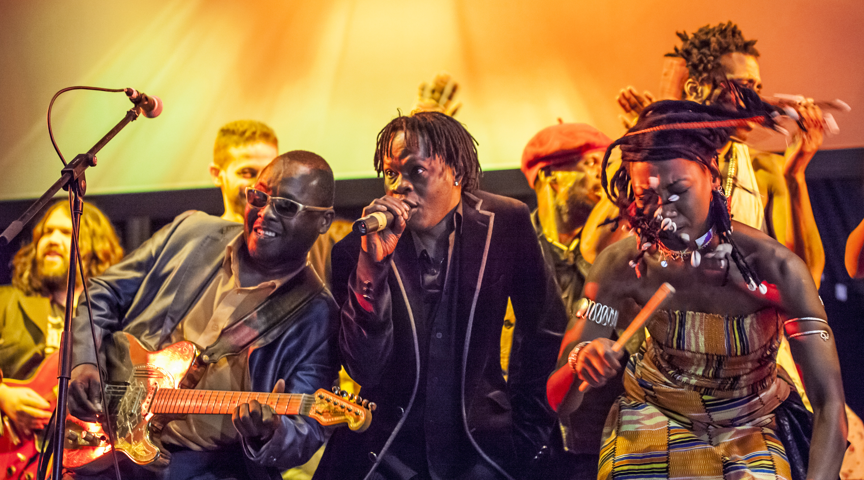
Damon Albarn’s Africa Express,
WHEN: 29 March WHERE: Leytonstone

Slide 11
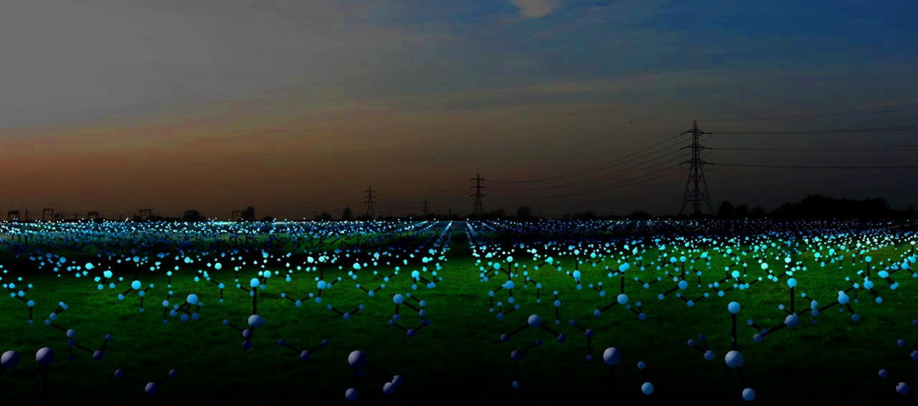

Molecules on the Marshes, by Zarah Hussain
WHEN: October – November WHERE: Marshes (Lee Valley)

Slide 12
A catalyst for the future:
Engaging a generation of young people to develop skills to enter the creative sector

Slide 13
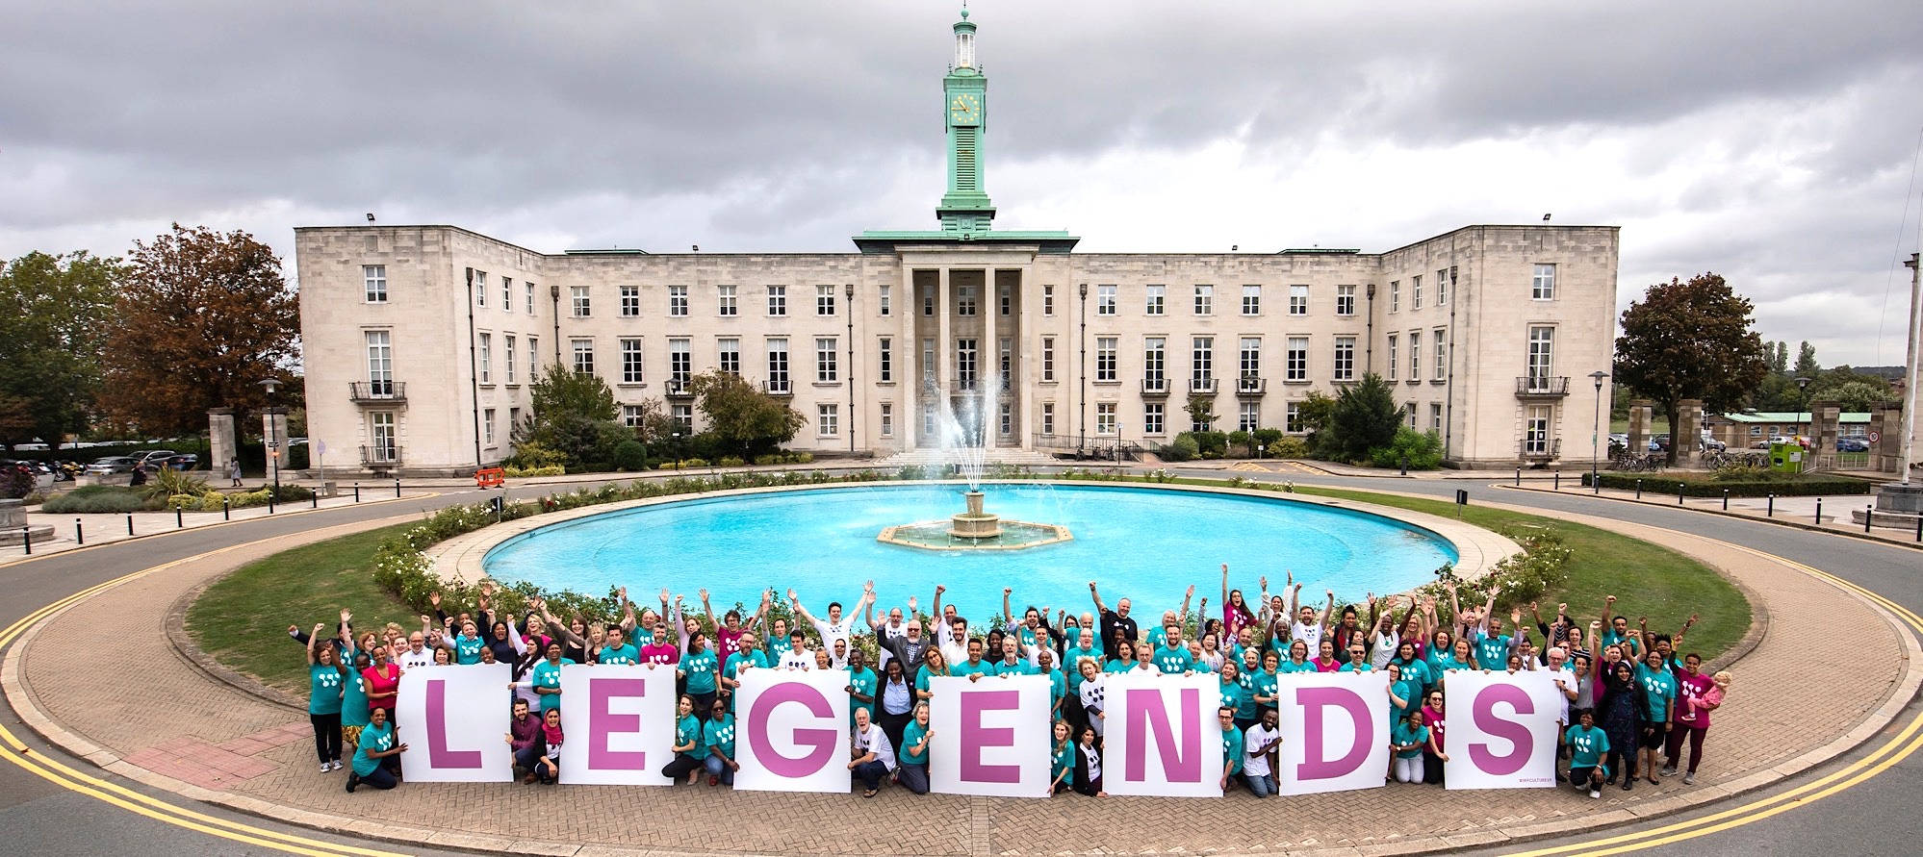
Our official volunteer programme

Slide 14

Culture as a career
Culture as a bond
Culture on every corner
Culture as identity
Cultural capacity
Leaving a lasting legacy

